Slide 1
CS-423 Computer Graphics

Slide 2
What computers do....
Process, transform, communicate information
Aspects of Communication
Origin (where does it come from?)
Throughput (how long will it take to get here?)
Latency (how long do I have to wait before something happens)?
Presentation (what does it look like?)
Computer Graphics is...
the technology for presenting information

Slide 3
Computer Graphics
Today, Computer Graphics has become the predominant form of computer output.
Even the text on most computer screens are "rendered" using computer graphics methods.

Slide 4
Computer Graphics
Computer Graphics is all about drawing pictures on computers, also called rendering.
The pictures can be photographs, drawings, movies, or simulations
-- pictures of things which do not yet exist and maybe could never exist.
-- Or they may be pictures from places we cannot see directly, such as medical images from inside your body.

Slide 5
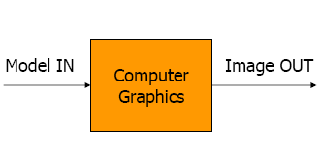
Computer Graphics
Drawing pictures on computers – “rendering”
Final output – colored pixels

Slide 6
Computer Graphics
The goal of computer graphics is to:
Create (synthetic) images indistinguishable from reality
Animations that are scientifically sound

Slide 7
What will you get out of this course?
Learn to draw on a computer (and appreciate what is involved in this task)
What this course is not…
It is not an art class
It is not a game design course

Slide 8
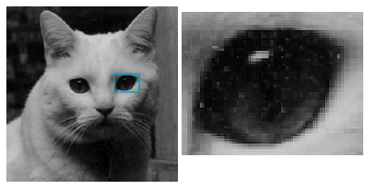
Pixels
A picture is produced by an n x m array of pixels (picture elements)
Also known as raster

Slide 9
Color Image (RGB)

Slide 10
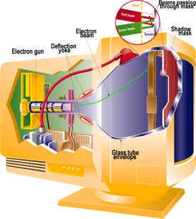
Pixels
Painted on the screen by CRT
Random scan
Raster scan

Slide 11
CRT
Most common display device a few years back
Evacuated glass bottle
Heating element (filament)
Electrons attracted to focusing anode cylinder due to strong positive charge on outer surface
Vertical and Horizontal deflection plates. The first set displaces the beam up and down, and the second displaces the beam left and right.
Beam strikes phosphor coating on front of tube

Slide 12
CRT
The phosphor then emits a small spot of light at each position contacted by the electron beam.
The light emitted by the phosphor fades very rapidly.
One way to keep the phosphor glowing is to redraw the picture repeatedly by quickly directing the electron beam back over the same points.
This is called refresh CRT.

Slide 13
CRT
The total number of points that can be plotted horizontally and vertically on a CRT is referred to as resolution.
The ratio of vertical points to horizontal points necessary to produce equal length lines in both directions on the screen is called aspect ratio of video monitor.

Slide 14
Raster Scan Displays
Based on television technology.
The electron beam is swept across the screen one row at a time from top to bottom.
During this scan, the beam intensity is turned on and off to create a pattern of illuminated spots
Picture definition is stored in a memory area called frame buffer.

Slide 15
Raster Scan Displays
The frame buffer holds the set of intensity values for all the screen points.
Stored intensity values are then retrieved from the frame buffer and painted on the screen one row at a time
One bit per pixel in black-and-white system (bitmap)
24 bits/pixel for color systems (pixmap)
Refresh rate of raster scan display is about 60 frames per second

Slide 16
Interlacing
On some raster scan systems, each frame is displayed in two passes using an interlaced refresh procedure.
In the first pass the beam sweeps across every other scan line from top to bottom.
After the vertical retrace the beam sweeps out the remaining scan lines.

Slide 17
Interlacing
Interlacing allows us to see the entire screen displayed in one-half the time it would have taken to sweep across all the lines at once.
Used with slow refresh rates.
Allows higher resolutions – that is scan more lines with less expensive components
The fading of phosphors between each pass is noticeable, causing the screen to flicker

Slide 18
Random Scan Display
CRT has the electron beam directed only to the parts of the screen where a picture is to be drawn.
Draw a picture one line at a time and also referred to as vector or calligraphic displays
Refresh rate depends upon the number of lines to be drawn
Picture definition is stored as a set of line drawing commands in refresh buffer.

Slide 19
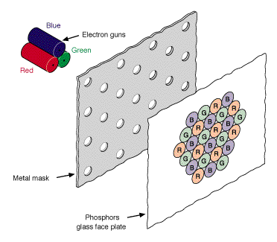
Color Video
More complicated.
The phosphors on the face of a color CRT are laid out in a precise geometric pattern.

Slide 20
Color Video
Within the neck of the CRT there are three electron guns, one each for red, green, and blue (the actual beams are all the same color-- invisible).
There is also a special metal plate just behind the phosphor, called a shadow mask.
This mask is aligned so that it simultaneously allows each electron beam to see only the phosphors of its assigned color and blocks the phosphor of the remaining two colors.

Slide 21
LCDs
Used in calculators, laptops.
Produce a picture by passing polarized light from the surroundings or from an internal light source through a liquid crystal material that can be aligned to either block or transmit the light.
Liquid crystal is a compound that has a crystalline arrangement, yet it can flow like a liquid.

Slide 22
Object Rendering
Modeling:
How to represent objects → mathematical specification of shape and appearance properties
Rendering
How to create shaded images from 3D computer models
Animation
How to represent motion → through sequence of images

Slide 23
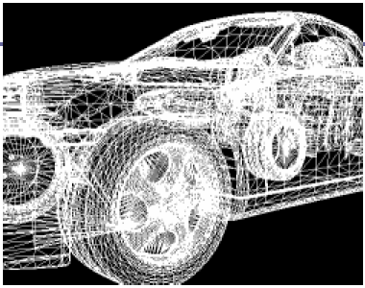
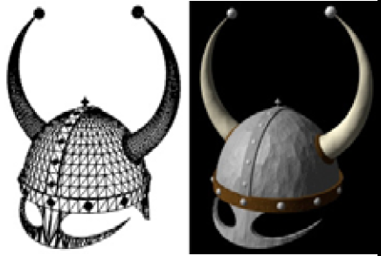
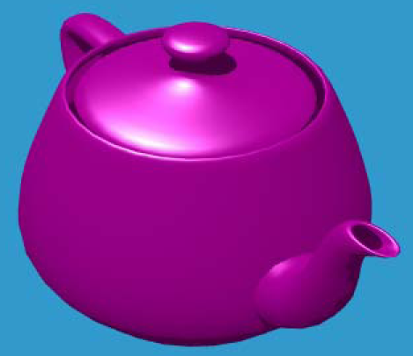
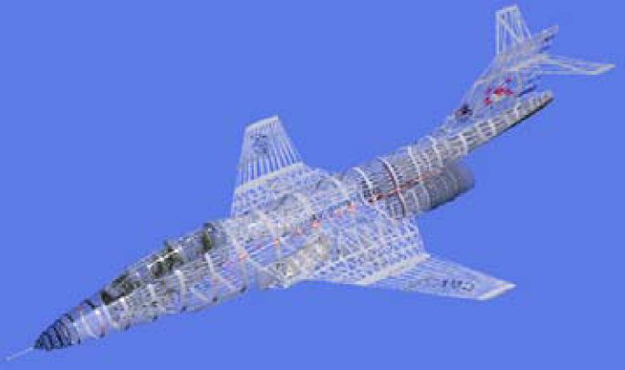
Modeling

Slide 24
Modeling
Deals with the mathematical specification of shape and appearance properties.
For example, a coffee mug might be described as
a set of ordered 3D points along with some interpolation rule to connect the points
and a reflection model that describes how light interacts with the mug

Slide 25
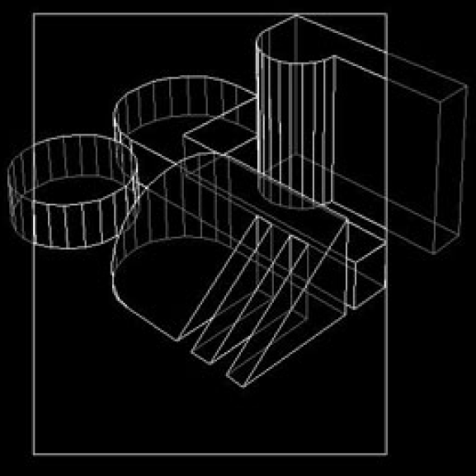
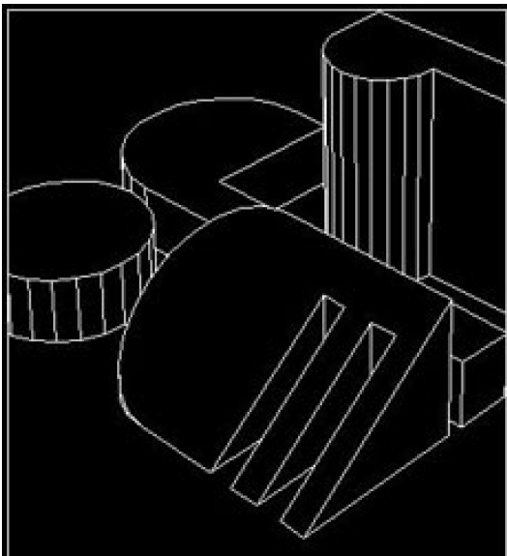
Rendering
creation of shaded images
from 3D computer models
Compute camera view
Clipping
Hidden line removal

Slide 26
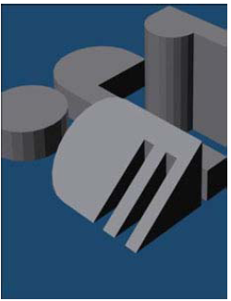
Rendering
Shading
Lighting
Shadows

Slide 27
Goal of Computer Graphics
Create (synthetic) images indistinguishable from reality
Animations that are scientifically sound

Slide 28
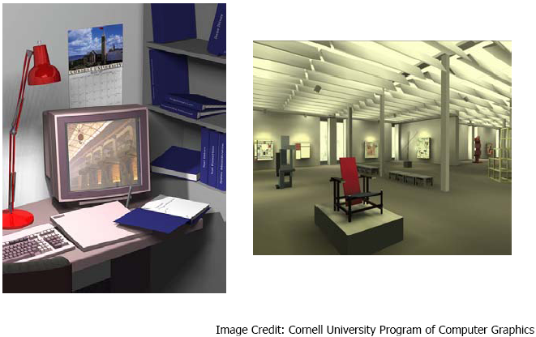
Goal of Computer Graphics

Slide 29
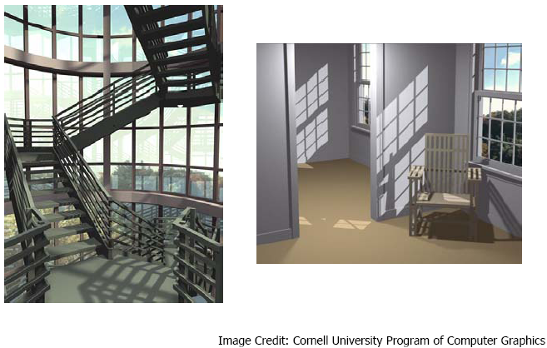
Goal of Computer Graphics

Slide 30
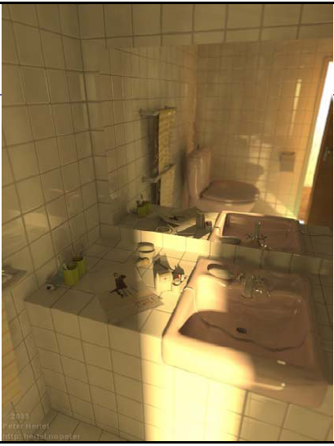
Goal of Computer Graphics

Slide 31
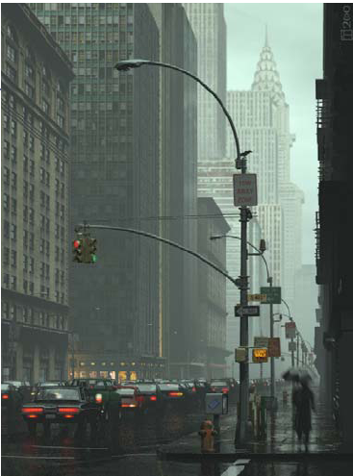
Goal of Computer Graphics

Slide 32
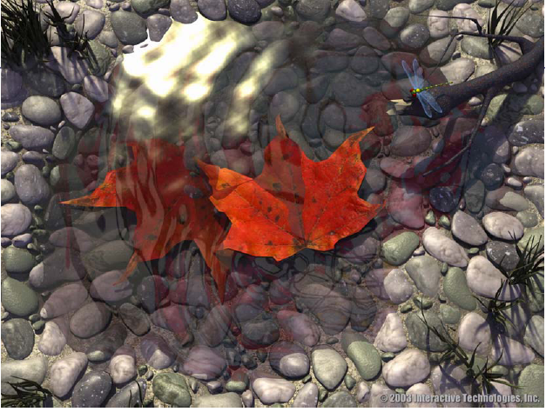
Goal of Computer Graphics

Slide 33
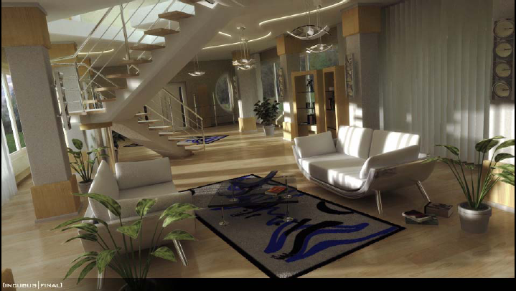
Goal of Computer Graphics

Slide 34
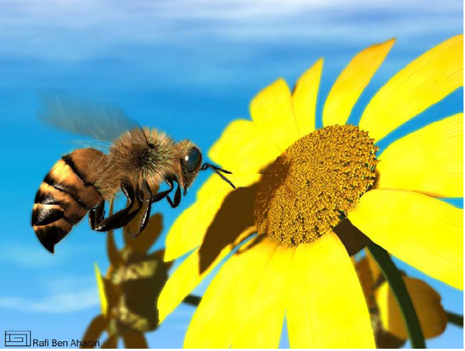
Goal of Computer Graphics

Slide 35
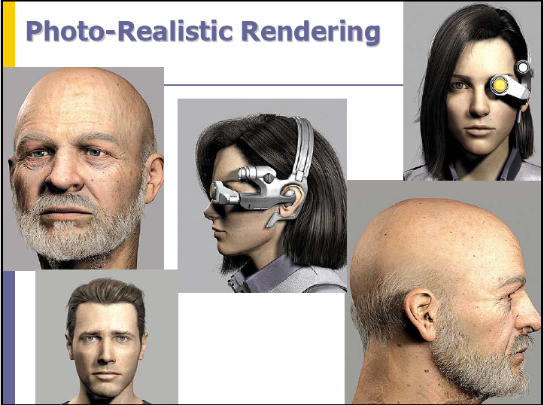
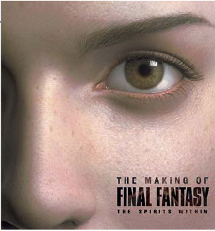
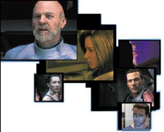
Final Fantasy
The first computer-generated animated motion picture with photo-realistic characters

Slide 36
Image Based Rendering
Generate synthetic images from real images
Structure (3D) has to be extracted for realistic rendering
So far, moving towards more realistic renderings:
Ray tracing
Radiosity
Image-Based Rendering
But that is not the goal of ALL computer graphics

Slide 37
Another Goal
Creating a new reality
Or simulating non-reality
Aesthetically pleasing
Entertainment or Education value

Slide 38
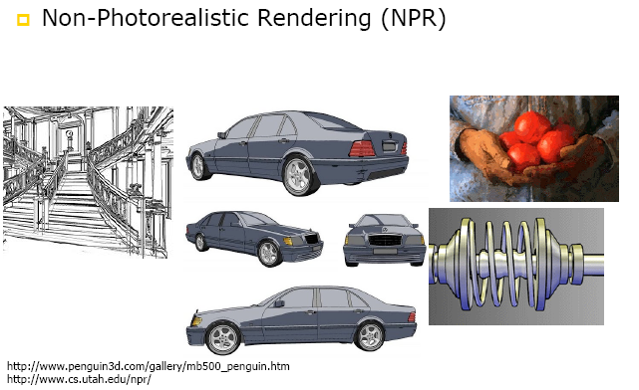
Another Goal

Slide 39
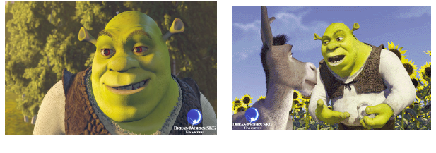
Another Goal

Slide 40
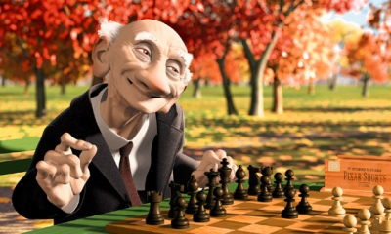
Application areas
Movies
If you can imagine it, it can be done with computer graphics.

Slide 41
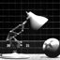
Movies
Luxo Jr : a desk light playing with a ball.
The first three-dimensional computer animated film to be nominated for an Academy Award, in addition to winning 20 awards at international film festivals.
Includes several technical achievements in computer animation, like self-shadowing, where an image accurately casts shadows onto itself.

Slide 42
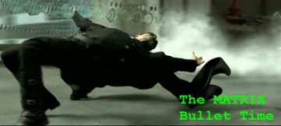
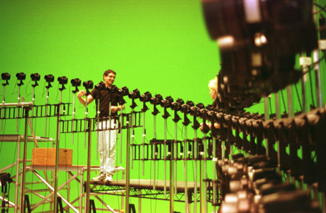
Movies
Great visual effects, e.g. bullet time
Concept is to play with motion and time in video or movie. The reason is to slow down or even freeze the time and let the audience see things around it more clearly at that particular moment in time.

Slide 43
Movies

Slide 44
Movies

Slide 45
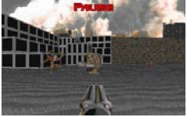
Games
Games are an important driving force in computer graphics.

Slide 46
Games
Games are an important driving force in computer graphics.

Slide 47
Games

Slide 48
Medical imaging
Computer graphics plays a significant role in saving lives.
The range of application: tools for teaching and diagnosis, all the way to treatment.

Slide 49
Computer Aided Design
Computer graphics has had a dramatic impact on the design process.
Today, most mechanical and electronic designs are executed entirely on computer.
Increasingly, architectural and product designs are also migrating to the computer.

Slide 50
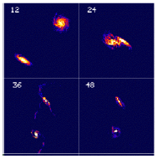
Scientific Visualizations
Computer graphics makes vast quantities of data accessible.
Numerical simulations frequently produce millions of data values. Similarly, satellite based sensors amass data at rates beyond our abilities to interpret them by any other means than visually.

Slide 51
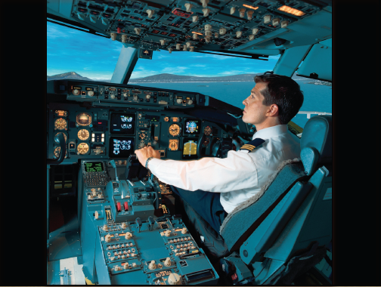
Simulation

Slide 52
Graphical User Interfaces
Graphical elements such as windows, cursors, menus, and icons are so common place it is difficult to imagine computing without them.

Slide 53
Program 1 – Reading / Writing Images
In this Program, you will learn…
Concept of R, G, B colors
Image manipulation in code
Reading and writing images in .ppm format

Slide 54
PBM, PGM, PPM Format
Portable Bit Map Formats
Simple Image header in ASCII
Image data in either ASCII or Binary
.PGM for Grayscale images
.PPM for Color (RGB) images

Slide 55
You will have to…
Write code to Read/Write BINARY .ppm and .pgm files
Images will be available through msteams

Slide 56
PPM Format
Header
P6
# Created by IrfanView
320 240
255
–ˆc™‡d˜ˆf™‰h_‡f_‹h›S+XR1ZQ3YSY
r g b r g b r g b r g b r g b r g b r g b r g b

Slide 57
PPM, PGM Format
Magic Numbers for format identification
P2 - ASCII PGM
P3 – ASCII PPM
P5 – Binary PGM
P6 – Binary PPM

Slide 58
Tasks
Read in the given .ppm and .pgm image files and load the data in any data structure of your choice, i.e. 1d arrays, 2d arrays, or array of structures etc.
From that data structures create a new copy of image with a different filename
HOW TO VIEW
Any .ppm viewer
IrfanView – (from irfanview.com)

Slide 59
Tasks
Subtract ambient. Make sure the intensity value doesn’t go beyond 0. This way you will be able to subtract two images other than ambient.
Extract single/two color layer(s)
Negative
Greyscale
Combine two images
Make a movie.

Slide 60
Deliverables
DUE: Sunday, March 2, 2024 at 11:00pm.
Code, executable… should take image names at run-time
Submit a report too.

